Slide 1

Autoencoders!!!
Hina Ali

Slide 2
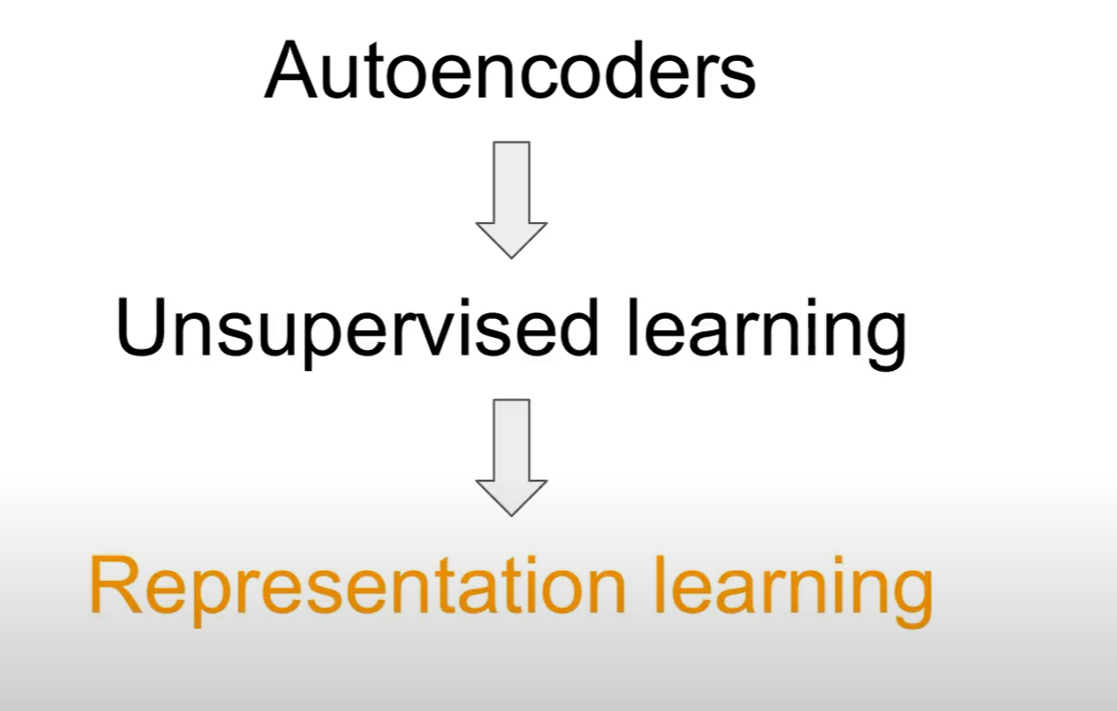

Slide 3
Autoencoders are a special type of unsupervised feedforward neural network (no labels needed!).
The main application of Autoencoders is to accurately capture the key aspects of the provided data to provide a compressed version of the input data, generate realistic synthetic data, or flag anomalies.
Autoencoders are composed of 2 key fully connected feedforward neural networks :
Encoder: (Compresses the input data into a lower-dimensional latent space.)
compresses the input data to remove any form of noise and generates a latent space/bottleneck
The output neural network dimensions are smaller than the input and can be adjusted as a hyperparameter to decide how much lossy our compression should be.
Decoder:(Reconstructs the original data from this compressed representation. )
making use of only the compressed data representation from the latent space, tries to reconstruct with as much fidelity as possible the original input data (the architecture of this neural network is, therefore, generally a mirror image of the encoder).
The “goodness” of the prediction can then be measured by calculating the reconstruction error between the input and output data using a loss function. By iteratively passing data through the encoder and decoder, measuring reconstruction error, and tuning parameters via backpropagation, the autoencoder gradually learns to handle complex data effectively.
The primary objective of autoencoders is to minimize the difference between the input and the reconstructed output, thus learning a compact representation of the data.
Notes:
Lossy Compression is a data compression technique where some amount of the original data is lost during the compression process to reduce the file size significantly
The size of the latent space determines the extent of compression. A smaller latent space forces the network to discard more information, leading to a lossy reconstruction but achieving better compression.

Slide 4
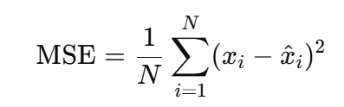

Reconstruction Error
An autoencoder aims to learn a compressed latent representation of input data using an encoder and decoder.
During training, the autoencoder minimizes the reconstruction error to ensure the output is as close as possible to the original input.
Mathematically, it can be represented as:
Reconstruction Error=Loss(Input, Reconstructed Output)
Common loss functions include:
Mean Squared Error (MSE) for continuous data. is the reconstructed output.
Where xi is original image and is reconstructed image
Cross-Entropy Loss for binary or categorical data.
Role of Reconstruction Error
Learning Representation: A lower reconstruction error indicates the autoencoder has learned an efficient latent representation.
Anomaly Detection: In anomaly detection, the model is trained on "normal" data. If reconstruction error is high, it indicates the input might be an outlier or anomaly.
Training Feedback: The reconstruction error acts as the feedback signal to optimize the autoencoder using backpropagation.

Slide 5
Role of Representation Learning
Representation learning helps autoencoders efficiently compress data by:
Discovering a compact representation of the input.
Learning the intrinsic structure of the data.
Encoding only the most relevant features into the latent space.
For instance:
Image Compression: Autoencoders learn to retain important visual features like edges, textures, and object structures, while removing noise or less noticeable information.
Audio Compression: Autoencoders focus on critical sound frequencies and patterns while discarding inaudible data.

Slide 6
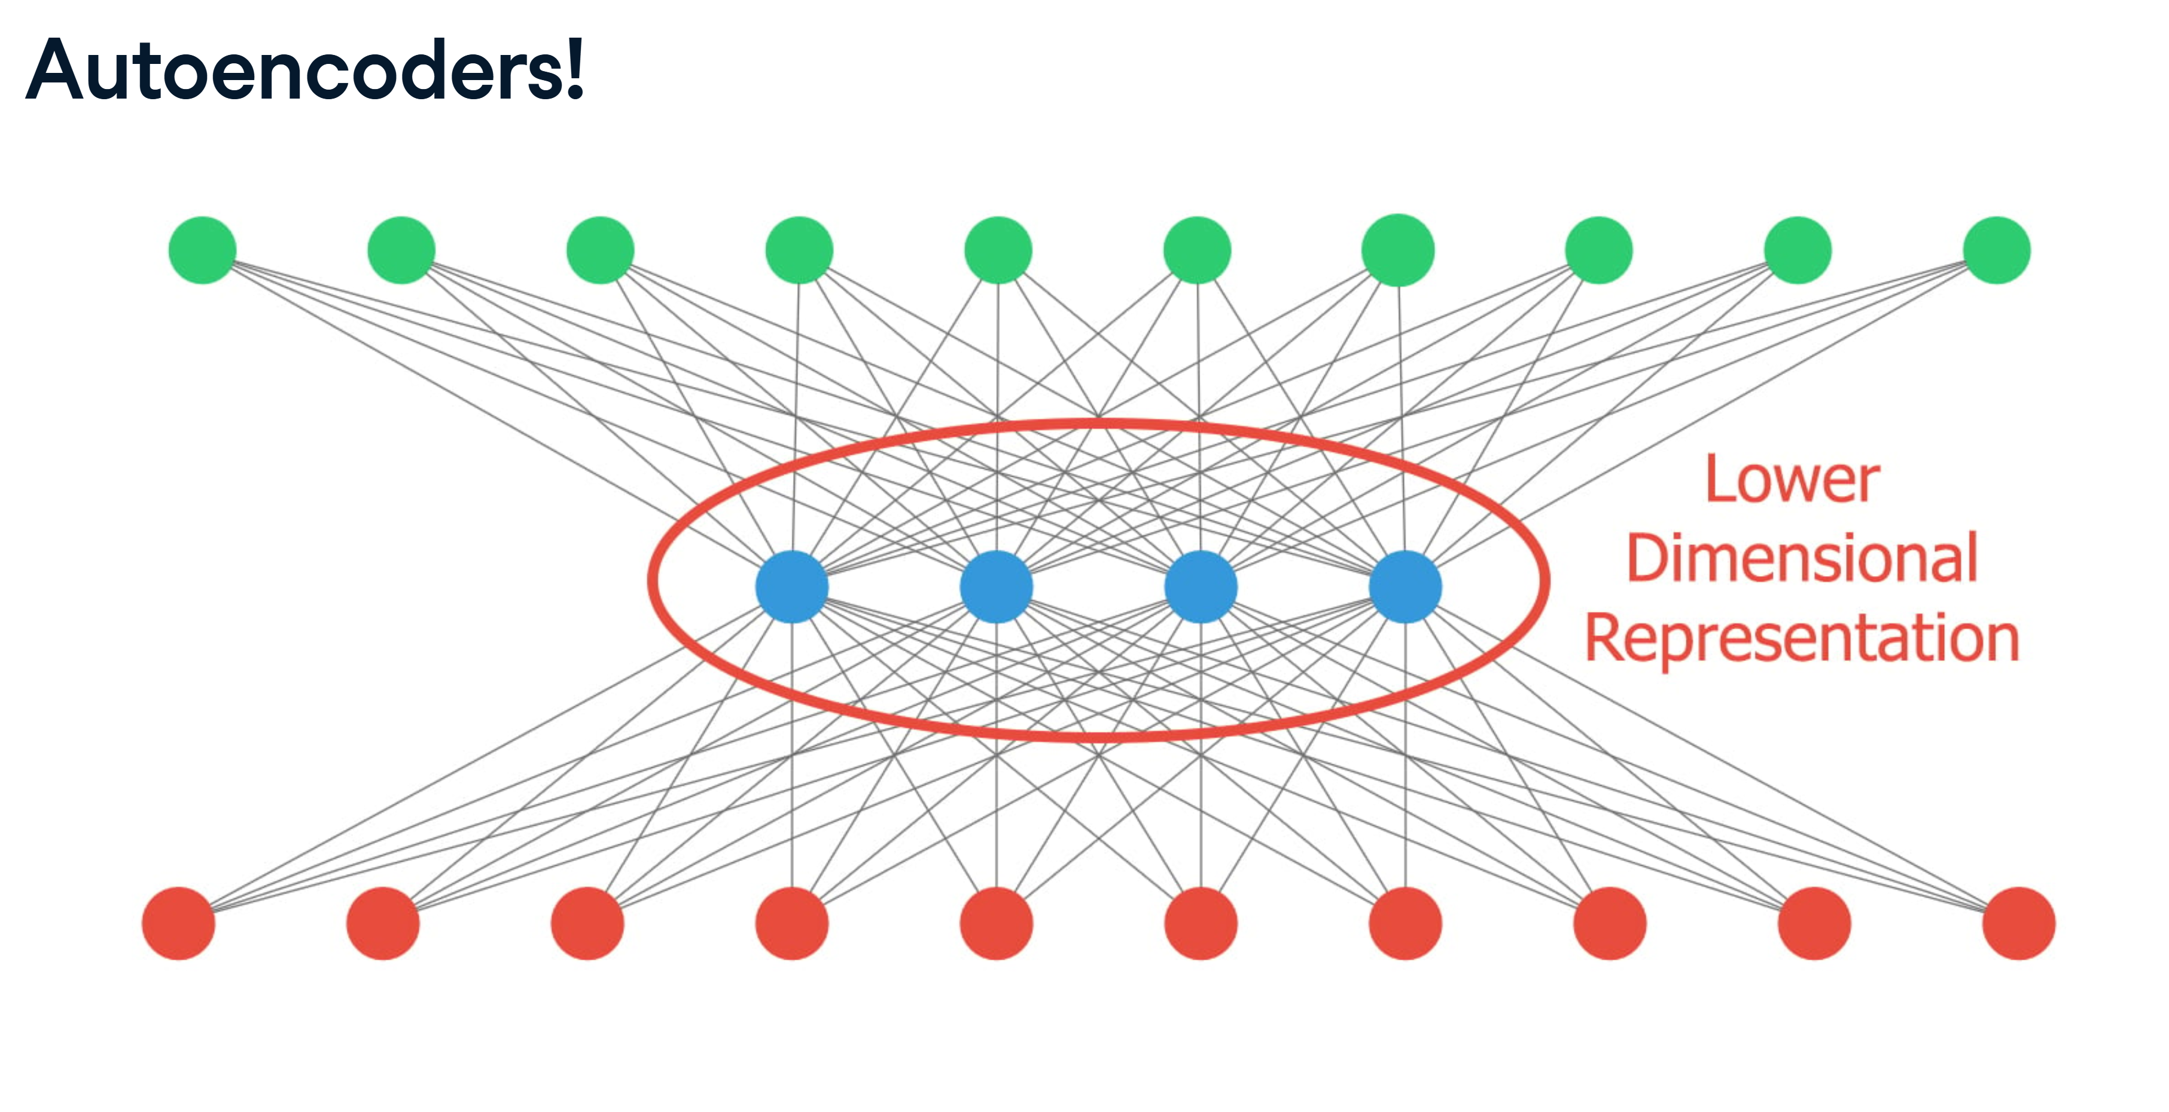

Slide 7
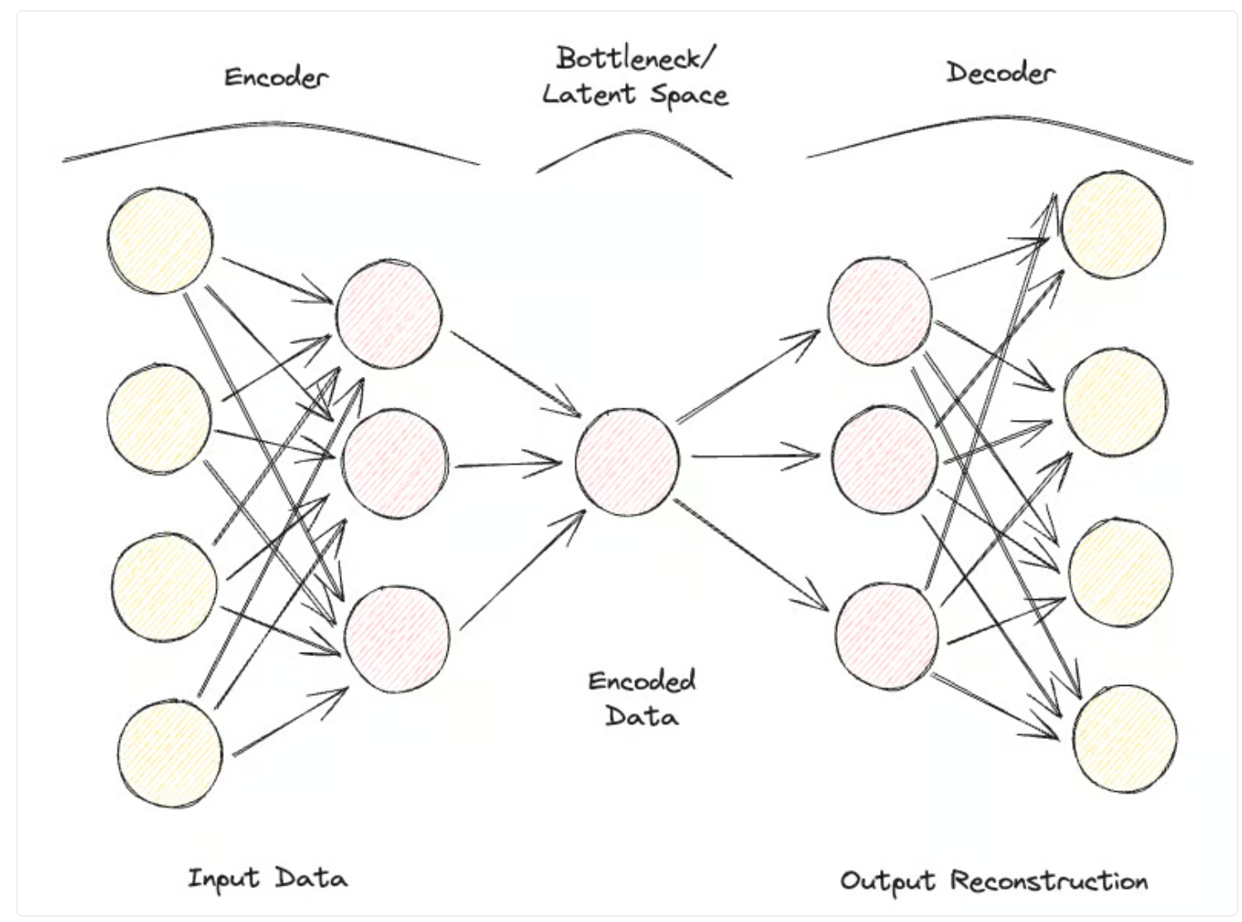

Slide 8
Independent Input Features Challenge:
If input features are completely independent, autoencoders struggle to find an effective lower-dimensional representation.
Results in significant information loss (lossy compression).
Autoencoders as Dimensionality Reduction:
Autoencoders can perform non-linear transformations to reduce dimensionality.
Offers advantages over traditional techniques like Principal Component Analysis (PCA), which are limited to linear projections.
Comparison to Standard Compression Algorithms:
They are specifically designed and optimized for data like what they were trained on.

Slide 9
Hyperparameter Tunning
Some of the most common hyperparameters that can be tuned when optimizing your Autoencoder are:
The number of layers for the Encoder and Decoder neural networks
The number of nodes for each of these layers
The loss function to use for the optimization process (e.g., binary cross-entropy or mean squared error)
The size of the latent space (the smaller, the higher the compression, acting, therefore as a regularization mechanism)
Regularization in autoencoders is used to improve generalization and prevent overfitting
Finally, Autoencoders can be designed to work with different types of data, such as tabular, time-series, or image data, and can, therefore, be designed to use a variety of layers, such as convolutional layers, for image analysis.
Notes:
Overfitting occurs when the model is too complex, memorizing the training data instead of generalizing to unseen data.
Training and Validation Loss Curves:
Low Training Loss: The model fits the training data perfectly.
High Validation Loss: The model performs poorly on unseen data.

Slide 10
Types of Autoencoders
Over the years, different types of Autoencoders have been developed:
Undercomplete Autoencoder
Sparse Autoencoder
Contractive Autoencoder
Denoising Autoencoder
Convolutional Autoencoder
Variational Autoencoder

Slide 11
Standard Autoencoders:
Autoencoders are a type of neural network designed to learn efficient data representations,
primarily for the purpose of dimensionality reduction or feature learning.
Encoder outputs a single value for each dimension.
Variational Autoencoders (VAE):
An extension of traditional autoencoders with a probabilistic encoding process.
Introduce uncertainty in latent representations by modeling them as distributions (typically multivariate Gaussian).
Key Difference from Standard Autoencoders:
Standard Autoencoders: Map inputs to fixed latent representations.
VAEs: Encode inputs into probability distributions over the latent space.
Key Application:
VAEs are widely used for generative tasks.
Sampling from distributions enables the decoder to generate new outputs beyond the deterministic approach.
Example:
Test a live Variational Autoencoder trained on the MNIST dataset online.

Slide 12
Real-life Applications of Autoencoders
Image Compression/Denoising
One of the main applications of Autoencoders is to compress images to reduce their overall file size while trying to keep as much of the valuable information as possible or restore images that have been degraded over time.
Anomaly Detection
Since Autoencoders are good at distinguishing essential characteristics of data from noise, they can be used in order to detect anomalies (e.g., if an image has been photoshopped, if there are unusual activities in a network, etc.)
Data Generation
Variational Autoencoders and Generative Adversarial Networks (GAN) are frequently used in order to generate synthetic data (e.g., realistic images of people).
Conclusion
In conclusion, Autoencoders can be a really flexible tool to power different forms of use cases. In particular, Variational Autoencoders and the creation of GANs opened the door to the development of Generative AI, offering us the first glimpses of how AI can be used to generate new forms of content never seen before.

Slide 13
Variational Autoencoders Theoretical Background
The encoder in a VAE outputs parameters of a probability distribution—typically the mean and variance of a Gaussian distribution. This allows the VAE to model data uncertainty and variability effectively.
Another neural network called a decoder is used to reconstruct the original data from the latent space representation. Given a sample from the latent space distribution, the decoder aims to generate an output that closely resembles the original input data. This process allows the VAE to create new data instances by sampling from the learned distribution.
The latent space is a lower-dimensional, continuous space where the input data is encoded.
Notes:
KL Divergence (Kullback-Leibler Divergence) is a measure of how one probability distribution Q (e.g., the learned latent distribution in a VAE) differs from a reference probability distribution P (e.g., a standard normal distribution N(0,I)

Slide 14
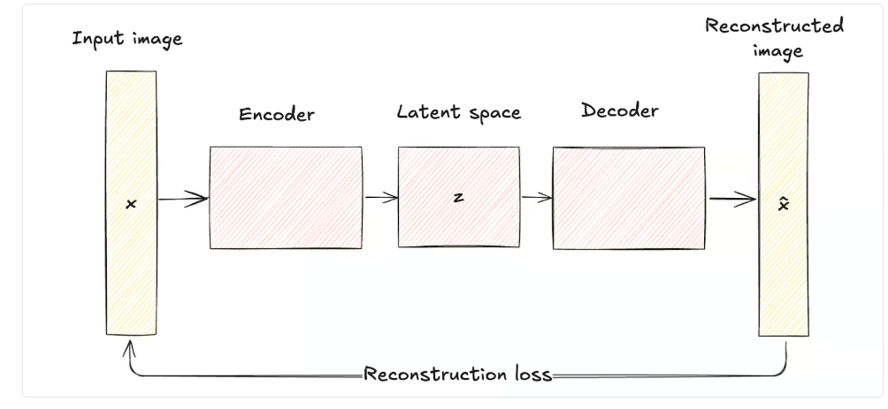
Architecture comparison

Slide 15
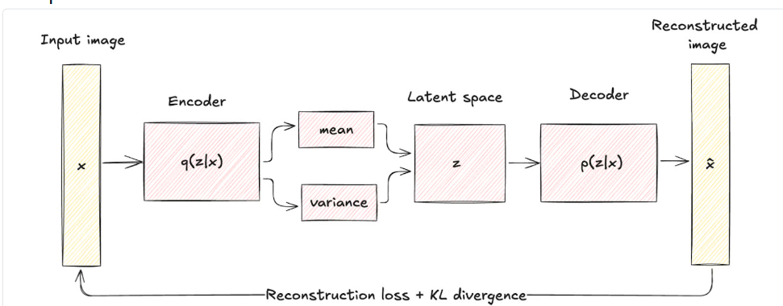
Architecture VAE

Slide 16
Types of VAE
Conditional variational autoencoder
Disentangled Variational Autoencoders
Adversarial Autoencoders (AAEs)
Variational Recurrent Autoencoders (VRAEs).
Hierarchical Variational Autoencoders (HVAEs)

